Slide 1
Conditionals

Slide 2
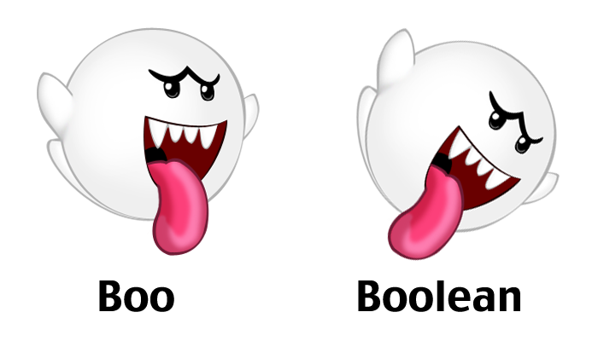
Booleans
There is no Boolean (true/false) type in C
Instead, we use 0 to represent false and 1 to represent true
Technically 0, NULL, and the
null char are false and anything else is true

Slide 3
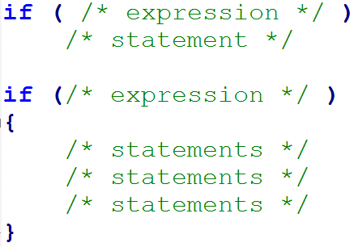
Conditionals – if statement
Blocks of code that, if/when a condition is met, runs
The simplest type of conditional statement is an if statement
An if can be read as: if expression is true, then execute statement(s)
The expression will evaluate to either true or false

Slide 4
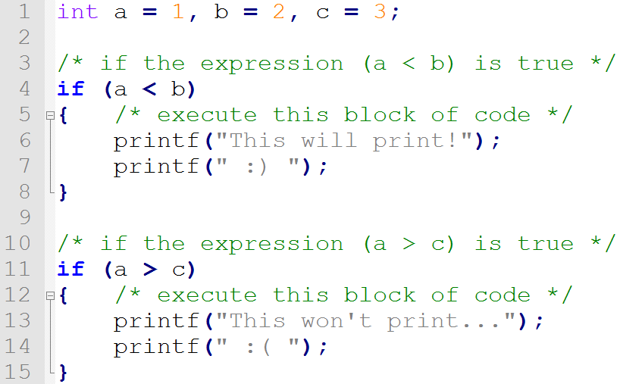
Example

Slide 5
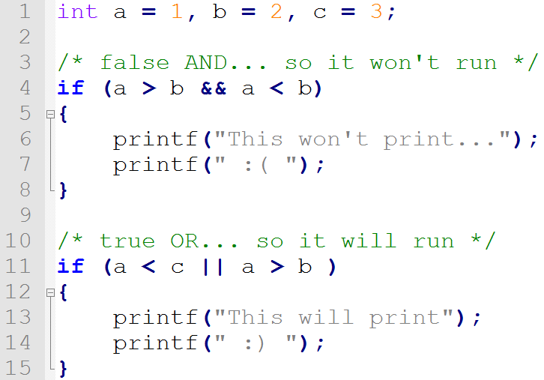
Short Circuit Evaluation
Boolean operators perform short circuit evaluation
A way for the computer to avoid unnecessary work
A simple rule is: false AND anything is false, true OR anything is true

Slide 6
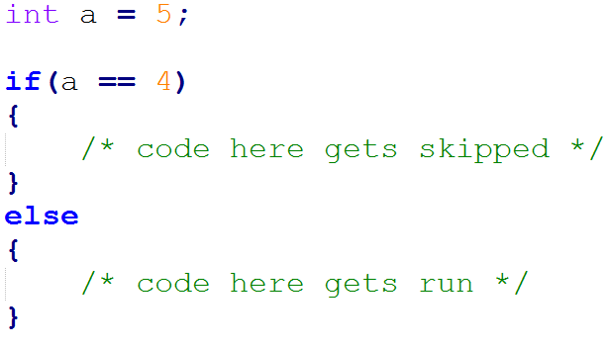
Conditionals – else statement
An if can include an optional else
Can be read as: if expression is true, execute this statement, else execute the other statement
Each if can only have one else

Slide 7
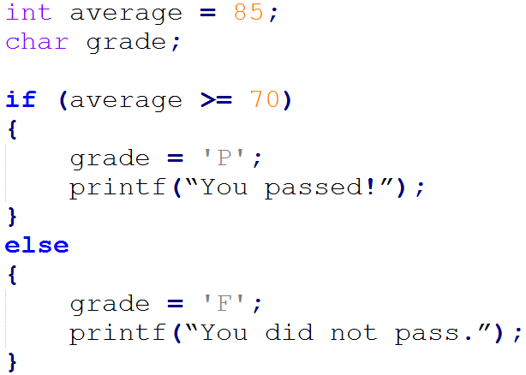
if else Example

Slide 8
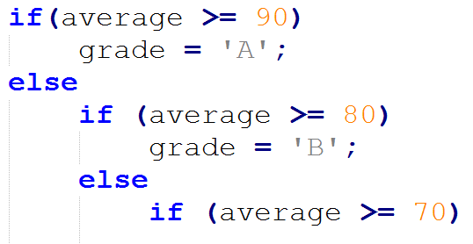
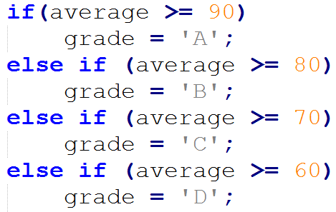
Nested ifs (else if)
incorrect
correct

Slide 9
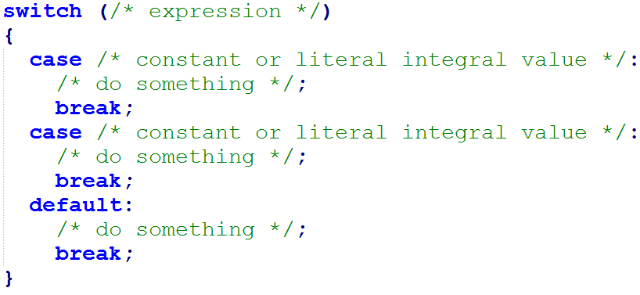
Conditionals - switch
A shortcut for else ifs
The main parts of a switch statement are:
case is like an else if
default is like an else
break skips the rest of the cases

Slide 10
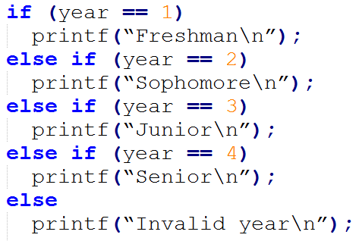
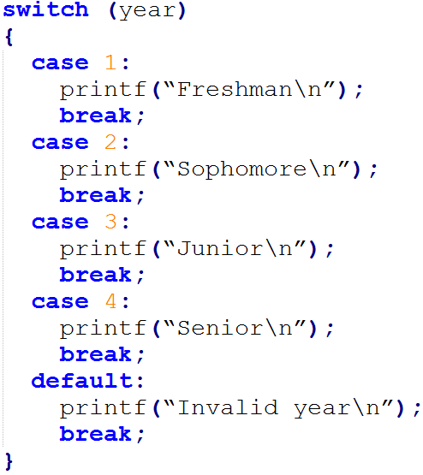
if/else versus switch
if/else
switch

Slide 11
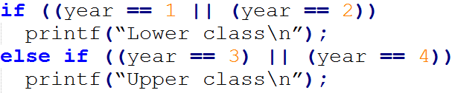
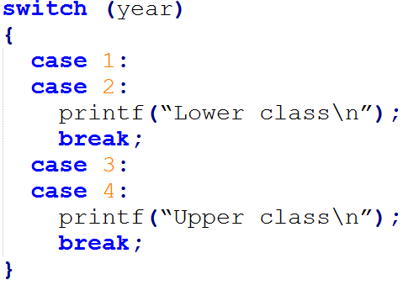
if/else versus switch

Slide 12
Summary
if statements run when the expression inside the parenthesis evaluates to true
ifs can have only one else, but infinite else ifs
switch statements can be used in the place of if/else if/else

Slide 13
Questions?

